Slide 1
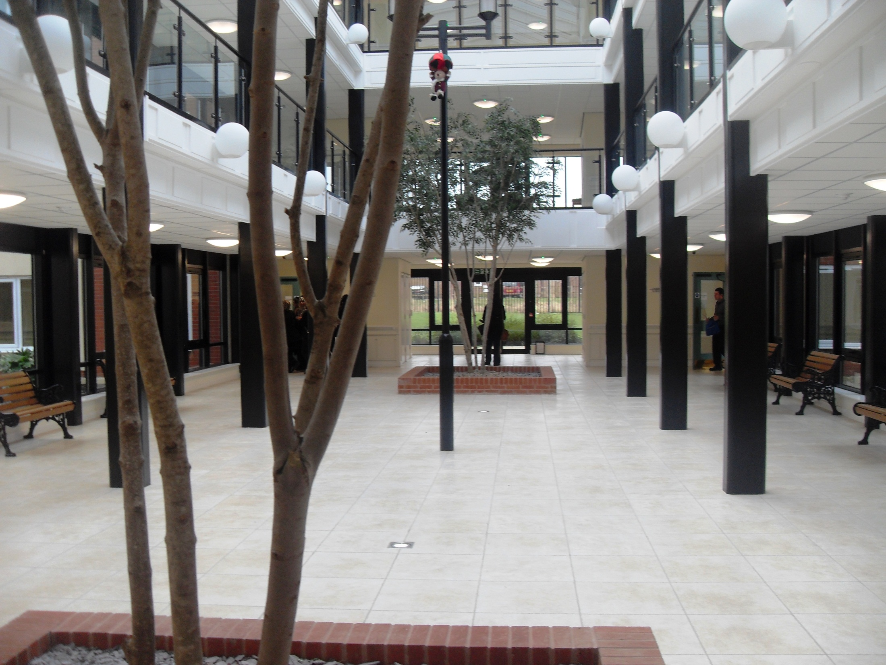
Developing the Care Workforce of the Future
A Presentation
By
Handsworth Wood Girls’ Academy
Yr. 13 Health and Social Care BTEC
Level 3 Subsidiary Diploma Group

Slide 2
The Students on the course are listed below. Most were able to attend the visits arranged by Midland Heart Housing Association.
The 2 visits attended were:
1) Snow Hill House, 86 Old Snow Hill, Birmingham B4 6DG. Accommodation for homeless people.
2) Broad Meadow, Red Kite Drive, Dudley , West Midlands, DY1 2GS. Homes for the elderly.
 | 13D HSC BTEC L3 | PJB
 | Surname | First Name
1 | Banari | Sonia
2 | Begum | Abidah
3 | Bi | Shabnum
4 | Chadni | Rukhsana
5 | Dhillon | Hardeep
6 | Dhupar | Jaswinder Kaur
7 | Farid | Adeeba
8 | Kaur | Gurjoth
9 | Kauser | Aneela
10 | Khan | Javeria
11 | Khan | Zara
12 | Mahay | Tina
13 | Mushtaq | Shabnum
14 | Raza | Sofia
15 | Seehra | Ishpreet
16 | Tanveer | Aroosa
17 | Younis | Maria

Slide 3
What is Midland Heart?
Midland Heart is the one of the top ten housing and care organisations based in the U.K.
Midland Heart supports those:
Who need help to live independently
Assist those in the community
Help individuals to discover their own ability
Transforms lives
They also provides homes for over 70,000 people

Slide 4
Brief history of Midland Heart?
Midland heart was established in the 1920’s, where this company became passionate about the community. This was done by improving slum housing in Birmingham.
Snow Hill:
In the 1920’s Snow Hill was originally a well known theatre which later on became a newly homeless service in the centre of Birmingham.
It was re-opened and launched to customers on 14th May 2012
The manager of snow hill is known as Carl Larter the Midland Heart director.
Broad Meadow:
Was developed by Midland Heart in partnership with Dudley Council, the homes and community and agency.

Slide 5
The job/roles within the care and support business of Midland Heart
Midland Heart supports challenging people; it has many support businesses available, such as:
learning disability services
youth services
mental health services
homeless services
support for residents to find jobs
services for older people
This opens a wide range of options for people who are jobless or who are looking for something like this.

Slide 6
Statistics:
Across England, approximately 48,510 households were accepted as homeless by local authorities in 2011.
69,460 children or expected children are in homeless households.
There are millions of people who are living in a rough situation.
Half a million people in Britain live on the streets. The other half live in squats or a temporary shelter.
Life expectancy is an estimate of the number of years that a person can expect to live.
Life expectancy at birth is 77 for males and 82 for females. A man who has already reached the age of 65 is expected, on average to live to the age of 82. While a women who has lived to be 65 is expected to live until the age of 85.

Slide 7
Recent study
A recent study / investigation (Panorama) came as a shock to the whole nation. At a care home, known as ‘Winter Bourne View’, vulnerable people were being mistreated by care workers who should have been looking after them. However they were not looking after the residents, but they were abusing the innocents. This left the nation with a wake-up call to what many care homes can be like.
In contrast Midland Heart has provided a positive, open service that can open up a lot of options for people and a good choice for people who were left doubtful about whether to put one of their family or a friend into the care of other people. Midland Heart should be publicised around the world so they can receive positive press and recognition for their work.
The CQC (Care Quality Commission) failed to recognise the bad care which was given in Winter Bourne View. However after this incident they have tightened up and are trying their utmost to ensure that clients in care homes are receiving the best possible care.

Slide 8
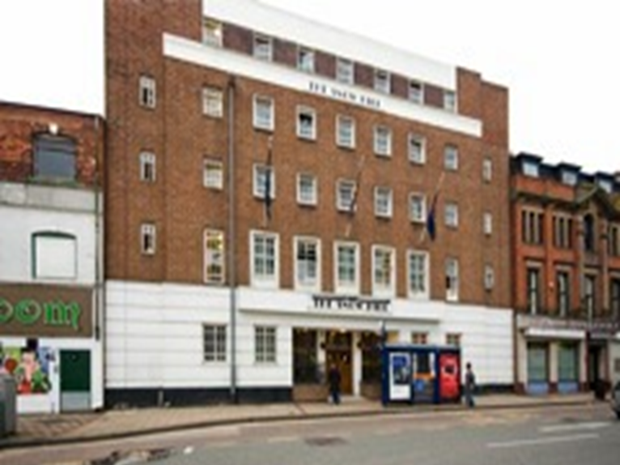
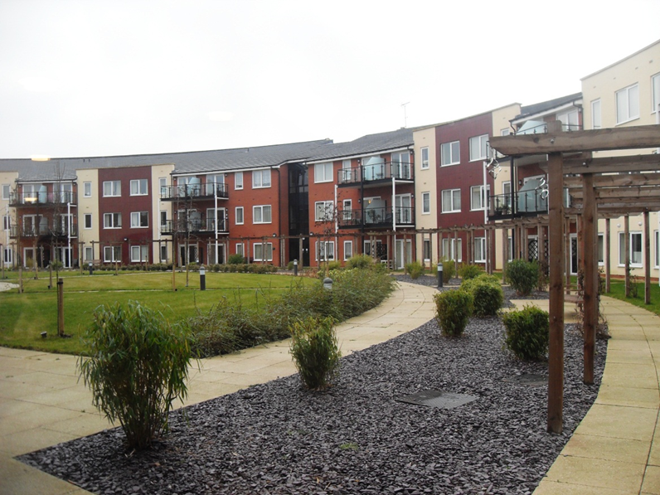
The Visits
We visited two places:
Snow Hill House, which is an accommodation for people aged 21 and over, and the Midland Heart Foyer, where the minimum age range is 16 and the maximum age range is 25.
The Broad Meadow, which is accommodation for old people aged 40 and over, also for guests.

Slide 9
What We Saw
Overall we:
Saw rooms for the homeless people.
We talked to the people who are being looked after.
We talked to the people who are providing the care to the homeless people.
Saw facilities provided for the homeless people in and out of their rooms.
Saw accommodation for old people.
We talked to the old people who are looked after.
We talked to the people who look after and care for the old people.
Saw facilities provided for the old people, for instance shops in Broad Meadow.

Slide 10
Activities &+ Experiences
Activities carried out were:
Viewing some well appointed rooms where the homeless and the old people live.
Put ourselves in a position of being old whereby we were struggling to carry out tasks that are easy for us being young. For example taking money out from a purse, playing cards, untangling ourselves from a string tied to a finger. All were done using gloves in order to feel the stiffness of the bones which the old people feel to see how difficult simple tasks can be for them.
In all these sorts of experiences, we found it very difficult to carry out these activities. This made us wonder how the old people carry out these kind of everyday tasks in Broad Meadow.

Slide 11
Demographics’ of old people
Britain's population is ageing fast, with statisticians predicting a huge increase in the number of 100 year olds by the next century. According to recent estimates, the number of people over 60 could rise by 40% in the next 30 years, although there is much dispute about the figures.
In 1995 there were less than 9 million people over 65 in the UK - by 2030 there may be about 13 million.
In 1951, there were 300 people aged 100 and over. By the year 2031, it is estimated that this figure could boom to 36,000.
With people living longer and longer because of medical and other advances, health experts believe the number of people suffering from debilitating conditions such as cancer and heart disease will grow and could mean a rising demand for nursing care.

Slide 12
Demographics’ of Homeless people
39% of the homeless population is young people under 18.
About 75% of homeless teens use drugs or alcohol as a means to self-medicate to deal with the traumatic experiences and abuse they face.
5,000 young people die every year because of assault, illness, or suicide while on the street.
A U.S. Department of Health and Human Services study found that 4% of homeless youth left their home because of physical abuse. 17% left because of sexual abuse.
Over 50% of young people in shelters and on the streets report that their parents told them to leave or knew they were leaving and didn’t care.
The average age a teen becomes homeless is 14 years.
1 in 7 young people between the ages of 10 and 18 will run away.
Teens age 12 to 17 are more likely to become homeless than adults.

Slide 13
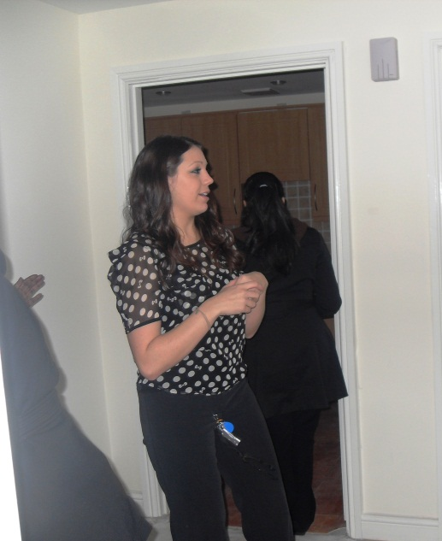
Staff we spoke to on our visit..
Martina Honeyghan – Came to visit us
Stephen Philpott – Gave us introduction on Snow Hill and gave a talk about demographics
Laura Edwards – Care worker in Broad Meadow
Sue Edwards – Manager of Broad Meadow

Slide 14
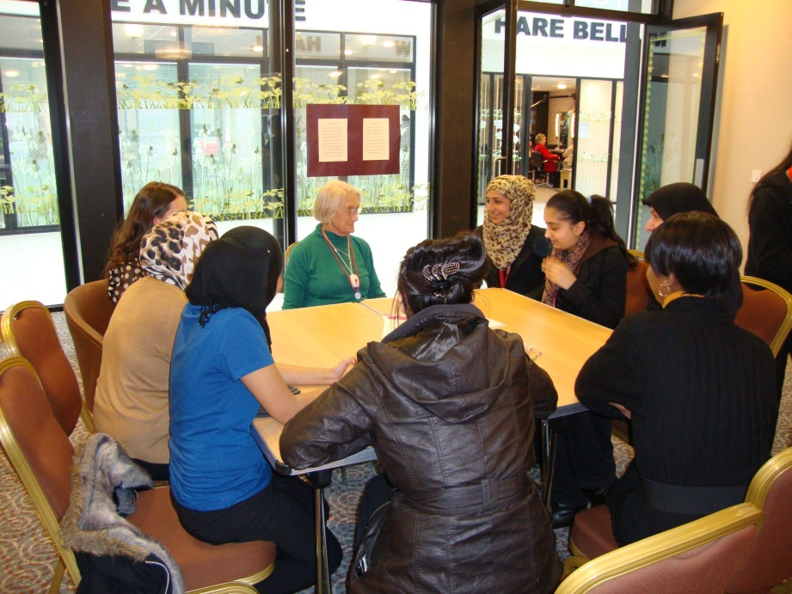
The Residents
We were lucky to get the chance to get to talk to a few people and ask questions. This really gave us all an insight into how they live their lives and what kind of care they receive from Midland Heart.
We noticed that many of the clients had different stories and received different levels of care. Such as in Broad Meadow they had a 3 level scheme of high, medium and low level of care.

Slide 15
What qualities are required from carers?
Qualities of carers:-
Enthusiastic
Keenness
Positive personality
Motivation
Smart
Organised
Reliable
Trustworthy
As well as most of the qualities listed above, experience is also a key aspect that should be kept in mind. Having more experience would mean that the carer would have more knowledge about what the requirements are and how to handle certain situations.
Dependable
Inspirational
Good communicator
Good time keeper
Trustworthy
Social able
Experienced
Clean

Slide 16
What kind of staff are needed at Midland Heart?
Midland Heart aims to recruit staff that are hard working and encourages staff members with a positive personality. Also they are looking for staff that would take the lead and take part in helping to organise events, this could be done in order to raise money.
Emily Dudley, Senior HR Adviser, Wellbeing for Midland Heart said: "It has been an amazing year for the Wellbeing programme; over 700 staff took part in the Midland Heart mile where each staff member completed a mile's rowing, running or cycling, which alone raised a massive £2200 for charity.
Staff who have the right drive and initiative to work in a challenging and rewarding environment that stimulates innovation and brings job satisfaction.

Slide 17
What qualification are needed..
There are no academic qualifications needed to be a care assistant; getting a job depends more on having the necessary skills and experience. Most care assistants receive on-the-job training from their employers which will equip them with the necessary skills and qualifications to do the job. All care assistants who work in adult social care are expected to undergo a twelve week induction programme which provides training in the basic aspects of being a care worker.
Why do we need carers in Britain ?
To support those who need help to live independently
To assist in regenerating communities
Help an individual to discover their own abilities
Maintain homes for more than 70,000 people

Slide 18
How can young people get the skills needed to work within a care setting
They can get the skills by doing a work experience or placement or training at a health and social care setting .
They can make their communication skills better by talking to people learning to be a cooperative team member and listen to others as well as putting their own view point across.
What kind of skills do you need ?
Here are a few skills you need to work within a health and social care settings:
Excellent and effective communication skills
Motivation and determination to help others
Enthusiasm
A caring personality

Slide 19
MANY THANKS TO THE MIDLAND HEART TEAM, WHO LET US GAIN THIS WONDERFUL EXPERIENCE AND ALSO GIVING US AN INSIGHT IN THE CARE GIVEN TO HELP THE HOMELESS AND THE CARE PROVIDED FOR THE ELDERLY.

